Slide 1

FINAL PRESENTATION OF MINI PROJECT
On the Topic
Machine Learning based approach for Diabetes Prediction
Project Members: | Amarjeet Kumar Singh (202002021073) Bhagyashree Nath (202002022099) Nerswn Baglary (202002022089)
Project Supervisor: | Dr. Pankaj Pratap Singh Assistant Professor (Senior Scale) Dept. of Computer Science & Engineering
Central Institute of Technology Kokrajhar
Computer Science & Engineering
Machine Learning based approach for Diabetes Prediction
May 30, 2023

Slide 2

OVERVIEW
Introduction
Related Works
Motivation
Problem Statement
Objectives
Proposed Mechanism
Summary
References
Machine Learning based approach for Diabetes Prediction
May 30, 2023

Slide 3
INTRODUCTION
Diabetes : A chronic disease that affects millions of people worldwide
Economic burden of Type 2 Diabetes (T2D) on society has increased over time
The number of people with diabetes rose from 108 million in 1980 to 422 million in 2014. Prevalence has been rising more rapidly in low- and middle-income countries than in high-income countries (source: WHO)
Early prediction of diabetes and prediabetes can reduce treatment costs and improve intervention
Health check up data taken as subject under test
A healthy diet, regular physical activity, maintaining a normal body weight and avoiding tobacco use are ways to prevent or delay the onset of type 2 diabetes.
Machine Learning based approach for Diabetes Prediction
May 30, 2023

Slide 4
EXISTING WORK
Author & Publication year | Topic | Methodology
Md. Maniruzzaman et al (3), 2020 | Classifcation and prediction of diabetes disease using machine learning paradigm | Three sets of ML-based classifiers as Naïve Bayes(NB), Decision Tree(DT) & Adaboost( AB) is used
Umair Muneer Butt et al (3), 2021 | Machine Learning Based Diabetes Classification and Prediction for Healthcare Applications | for the predictive analysis of diabetes, long short-term memory (LSTM), moving averages (MA), and linear regression (LR) is used
Aishwarya Mujumdara et al (1), 2019 | Diabetes Prediction using Machine Learning Algorithms | Various ML algorithms is used for predicting diabetic nature in patient
Machine Learning based approach for Diabetes Prediction
May 30, 2023

Slide 5
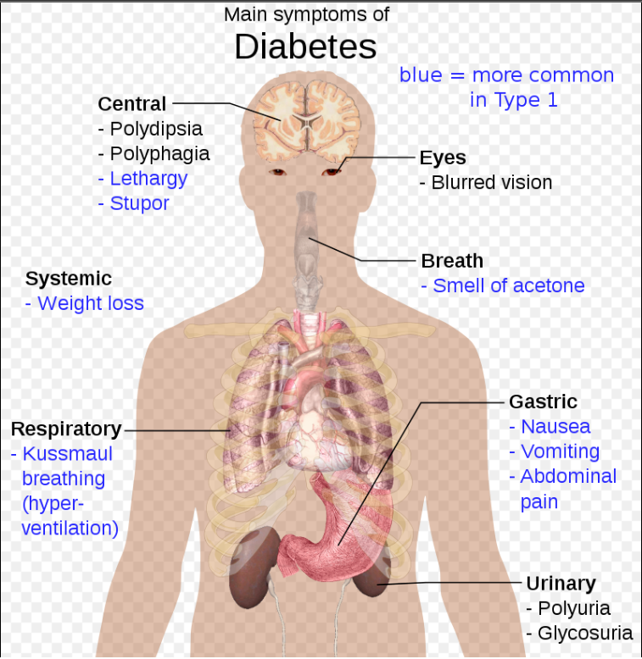
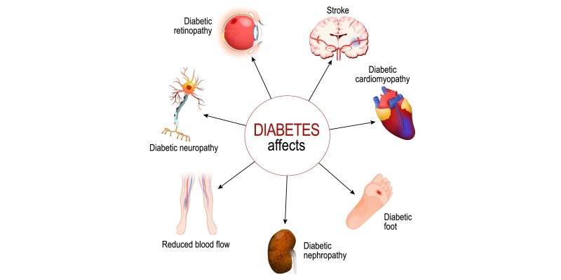
MOTIVATION
“ Trying to manage diabetes is hard because if you don’t, there are consequences you’ll have to deal with later in life ” - Bryan Adams
One of the primary motivations for developing an ML-based diabetes prediction model is the potential for early detection and intervention.
[Source: @Wikipedia]
[Source: rghospitals.com]
Machine Learning based approach for Diabetes Prediction
May 30, 2023

Slide 6
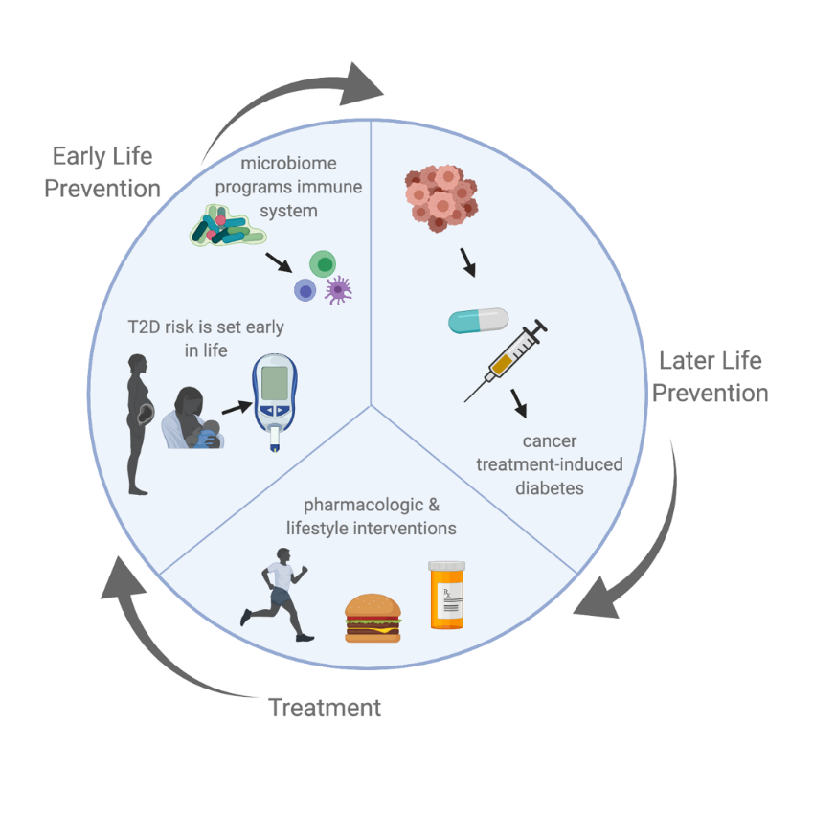
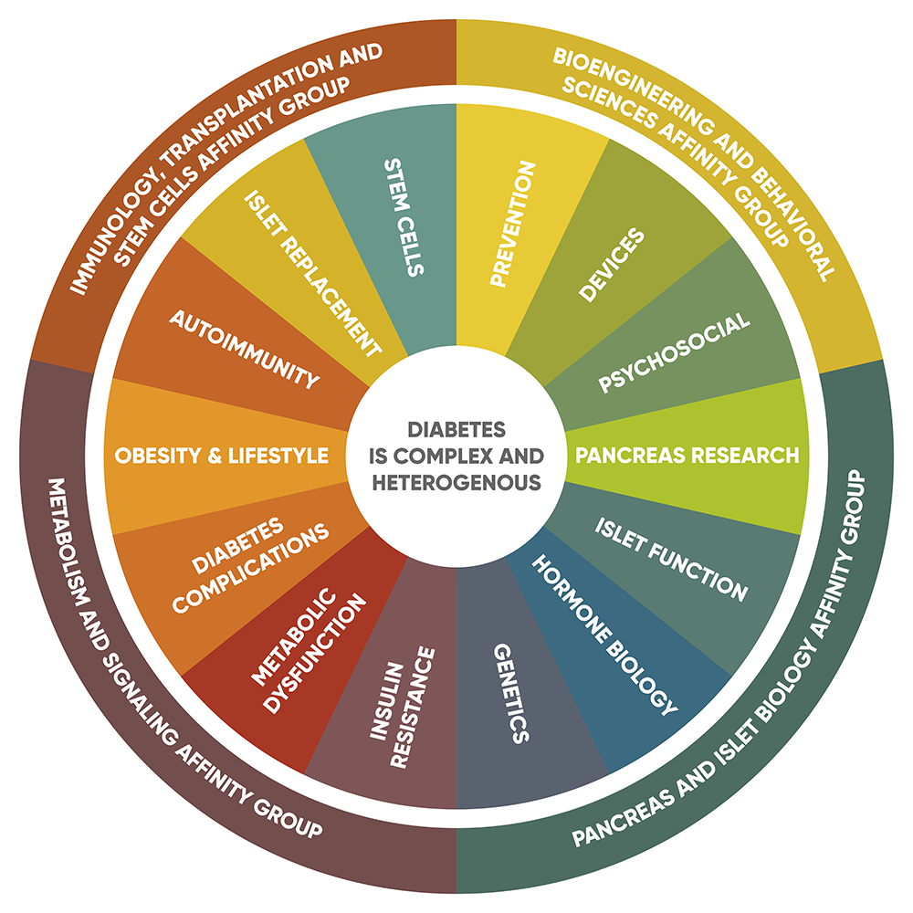
PROBLEM STATEMENT
To build an efficient model which can predict diabetes
Implementing latest technological advancements such as Machine learning
Compare and contrast the best model for finding diabetes
[Source: Stanford diabetes research center]
[Source: ouhealth.com ]
Machine Learning based approach for Diabetes Prediction
May 30, 2023

Slide 7
OBJECTIVES
The goal of this project is to develop a machine learning model that can accurately predict the likelihood of a person having diabetes based on various clinical features
The main objective of this project is to provide accurate predictions which can be used to provide early alert for patients
The proposed solution for ML based diabetes prediction presents cost-effective, reliable and technically simple solution
This approach believes that using the Machine Learning Humans can be benefited and their life can be saved.
Machine Learning based approach for Diabetes Prediction
May 30, 2023

Slide 8
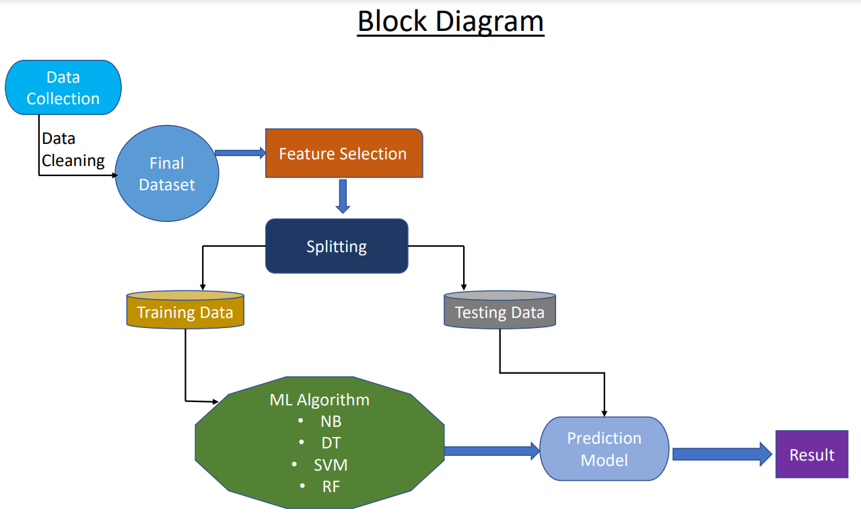
BLOCK DIAGRAM
Machine Learning based approach for Diabetes Prediction
May 30, 2023

Slide 9
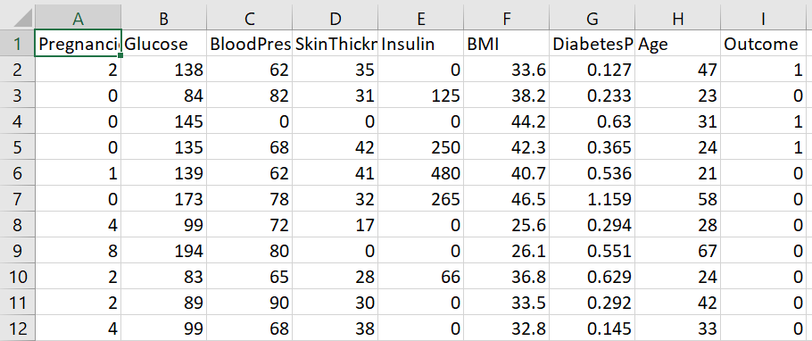
DATASET
Dataset has been taken from Kaggle containing the values Glucose level, Pregnancies, Blood Pressure, Skin Thickness, Insulin, BMI and age
Table: Pima Indian Diabetes Dataset
Machine Learning based approach for Diabetes Prediction
May 30, 2023

Slide 10
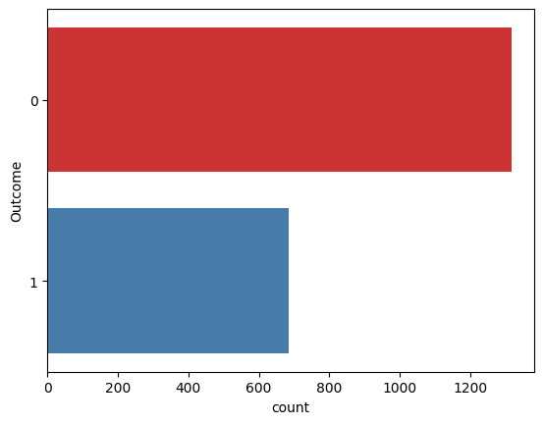
DATASET
Outcome 0 and 1 means person is Non-diabetic and Diabetic respectively
Machine Learning based approach for Diabetes Prediction
May 30, 2023

Slide 11
PROPOSED MECHANISM
Pre processing of data before going through the model has been done
80% data taken for training and 20% data taken for testing
Trained model based on concept support vector machine, Random Forest, Naïve Bayes, Decision Tree
Makes a prediction on the standardized input data using the trained classifier and give the prediction result based on the predicted class label.
Machine Learning based approach for Diabetes Prediction
May 30, 2023

Slide 12
PROPOSED MECHANISM
Various machine learning algorithms is compared and best among all is selected for the prediction
Evaluating the model whether it is right or not
Machine Learning based approach for Diabetes Prediction
May 30, 2023

Slide 13
WORK DONE
Accuracy of Different ML Classifiers are:
Classifier Name | Accuracy
Support Vector Machine | 78%
Random Forest | 97%
Naïve Bayes | 73%
Decision Tree | 79%
Machine Learning based approach for Diabetes Prediction
May 30, 2023

Slide 14
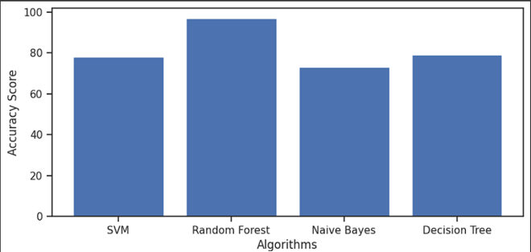

Slide 15
SUMMARY & FUTURE SCOPE
,
Based on the analysis among the classifiers support vector machine, Decision Tree, Random Forest and Naïve Bayes, The Random Forest method is giving the accuracy of 97% which is the highest among all
Random Forest is used to predict diabetes and can be suggested as better model to the patients
Health Insurance policy Suggestion can be the application of this Diabetes prediction. The policy suggestion is directly related to the most accurate model. For Health policy suggestion, It can be classified it into three categories like Type A, B & C Health Policy
Machine Learning based approach for Diabetes Prediction
May 30, 2023

Slide 16
REFERENCES
,
Md. Maniruzzaman, Md. Jahanur Rahman , Benojir Ahammed and Md. Menhazul Abedin, “Classifcation and prediction of diabetes disease using machine learning paradigm”, “Health Information Science and Systems”, 2020 : (1-14), https://link.springer.com/article/10.1007/s13755-019-0095-z
Umair Muneer Butt , Sukumar Letchmunan , Mubashir Ali ,Fadratul Hafinaz Hassan ,Anees Baqir , and Hafiz Husnain Raza Sherazi, “Classification and Prediction for Healthcare Applications”, “Hindawi Journal of Healthcare Engineering”, “Machine Learning Based Diabetes : (1-17), https://www.hindawi.com/journals/jhe/2021/9930985/
Pima Indians Diabetes Database, “Predict the onset of diabetes based on diagnostic measure”, Kaggle , https://www.kaggle.com/datasets/uciml/pima-indians-diabetes-database
Aishwarya Mujumdar , V Vaidehi Dr. , “Diabetes Prediction using Machine Learning Algorithms”, “ScienceDirect”, 2019 : (1-8), “https://www.sciencedirect.com/science/article/pii/S1877050920300557”
Machine Learning based approach for Diabetes Prediction
May 30, 2023

Slide 17
Thank You
Machine Learning based approach for Diabetes Prediction
May 30, 2023

